Slide 1
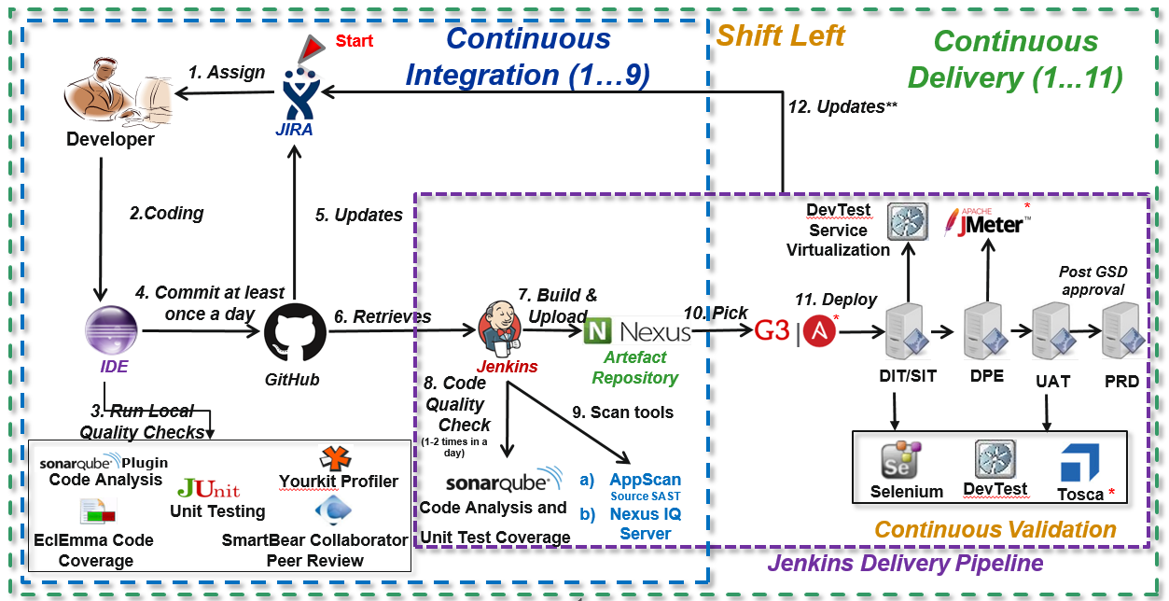
DevOps Tooling A Day in the Life of a DevOps Developer

